Slide 1
2017
Safety Symposium
Monday, May 9th

Slide 2
Plan Provide Train

Slide 3
Fall Protection and Construction Safety

Slide 5
Learning Objectives
Share construction Fall Protection and Fall Prevention best practices
Discuss Ladder Safety
Exchange ideas on how to manage continuous improvement of your Fall Hazards Exposures
Discuss Resources

Slide 6
4th Fall Protection Stand-Down – May 8-12. 2017
Plan - ahead to get the job done safely.
Provide - the right equipment.
Train - everyone to use the equipment safely.

Slide 7
Construction Safety by the Numbers
4% Increase in fatalities in the private construction industry between 2014-2015 (BLS).
6,929 Fall-protection violations recorded in 2016 (OSHA).
9.7 / 100,000 Construction vs. 3.3 /100,000 All Workers – Fatality Rate
*$1.5M Fine paid by Massachusetts contractor in response to a fatal trench collapse in 2016.
Credit: Construction Dive

Slide 8
Construction Safety by the Numbers
48,000 Total decrease in number of injuries (all industries) between 2014-2015 (BLS).
553,000 Number of worker lives (all industries) that “have been saved” since OSHA Act.
Credit: Construction Dive

Slide 9
FALLS KILL
FALLS are the leading cause of construction fatalities and account for one-third of on-the-job injury deaths in the industry.
Each year in the U.S. more than 200 construction workers are killed
Each year over 10,000 construction workers are seriously injured by falls.

Slide 10
Falls - Key Finding
Between 2011 and 2015, the annual number of fall fatalities in construction increased by 36%, exceeding the growth in employment and total fatalities in this industry.
More than half (55%) of fall fatalities in construction occurred at a height of 20 feet or less.
Falls from roofs comprised one-third of fall deaths, followed by falls from ladders (24%).
Fall fatalities in residential construction increased from 26 deaths in 2011 to 61 deaths in 2015, more than double.
Roofers had the highest rate of fall fatalities in construction; however, the number and rate of fatal falls in this occupation decreased in 2015.
Hispanic workers, foreign- born workers, and workers aged 55 or older had an elevated risk of fatal falls.
From 2014 to 2016, the National Safety Stand- Down events reached more than 5 million workers across the nation.

Slide 11
Plan Provide Train

Slide 12
FALLS
OSHA’s Focus Four Hazards Toolbox Talks

Slide 13
OSHA Focus Four – 85%* OF CONSTRUCTION FATALITES
Falls – Anything that could cause a worker to lose balance or bodily support and result in a fall can be considered a fall hazard
Caught in Between – When a person becomes caught, squeezed, crushed, pinched, or compressed between two or more objects or parts of an object. Unguarded moving machinery, unprotected excavations and trenches, working between moving materials and immovable structures, vehicles or equipment are all considered caught-in-between hazards
Electrocutions – When a person is exposed to electrical energy, the result can be electrocution.
Struck By – A struck-by hazard can be any flying, falling, swinging or rolling object like falling equipment loads and faulty overhead power lines.

Slide 14
Plan Provide Train

Slide 15
Where do Falls Occur?
Fall Protection – 1926 Subpart M
Ladders – 1926 Subpart X
Scaffolds – 1926 Subpart L
Steel Erection – 1929 Subpart R
Other Exposures
Roofs
Floor Openings
Equipment / Arial Lifts
_________________

Slide 17
LADDERS
1/4 of All Construction Fall Fatalities
Seven Steps of Ladder Safety
Extended Ladder three feet above top surface
Tie-off at the top
Three points of contact
Do not use if ladders has broken rungs or sides
1’ back for every 4’ foot in height
Never carry tools on ladder
Secure ladder at the bottom
**** Right Ladder for the Job*****

Slide 18
Hierarchy of Controls

Slide 19
Competent Person – Missing Link?
Is defined as “one who is capable of identifying existing and predictable hazards is the surrounding or working conditions which are unsanitary, hazardous or dangerous to employees, and who has the AUTHORITY to take PROMPT corrective measures to eliminate them.” 29 CFR 1926 32(f)

Slide 20
Plan Provide Train

Slide 21
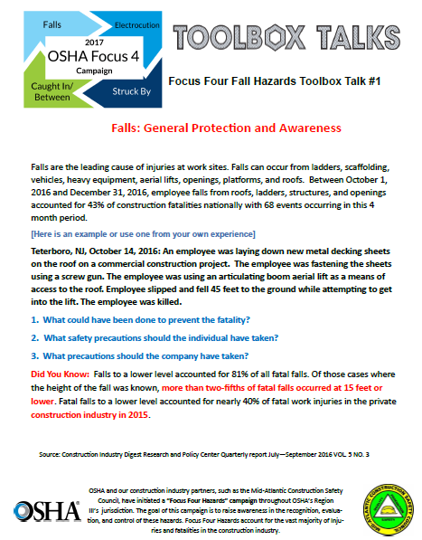
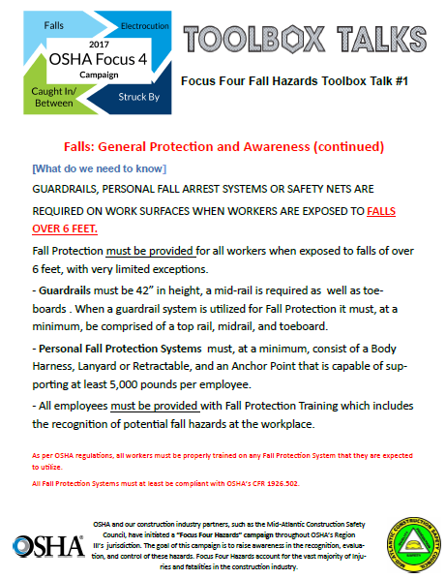
#1 – Falls: General Protection and Awareness

Slide 22
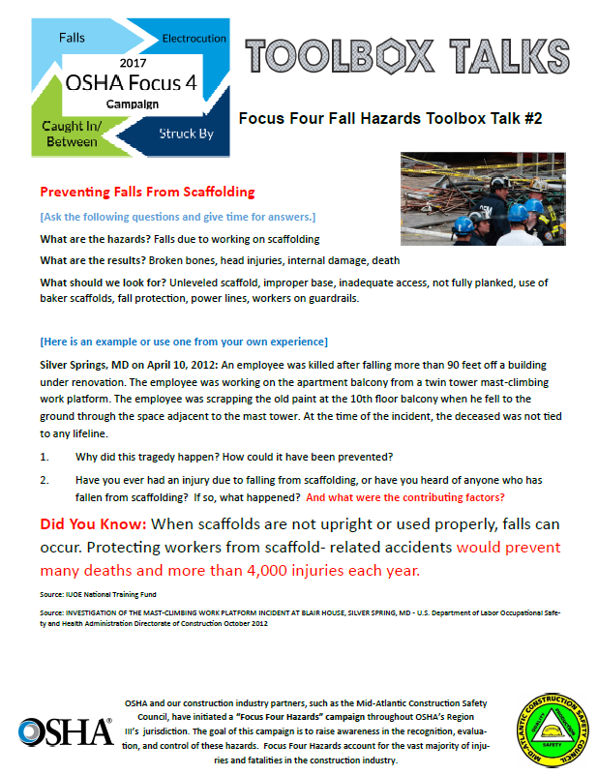
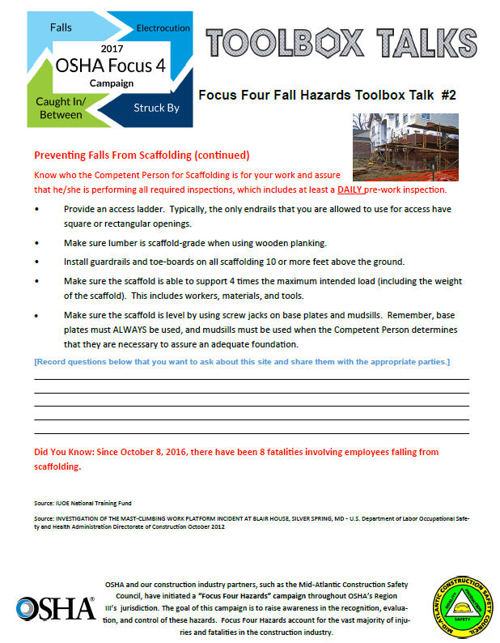
#2 – Preventing Falls From Scaffolding

Slide 23
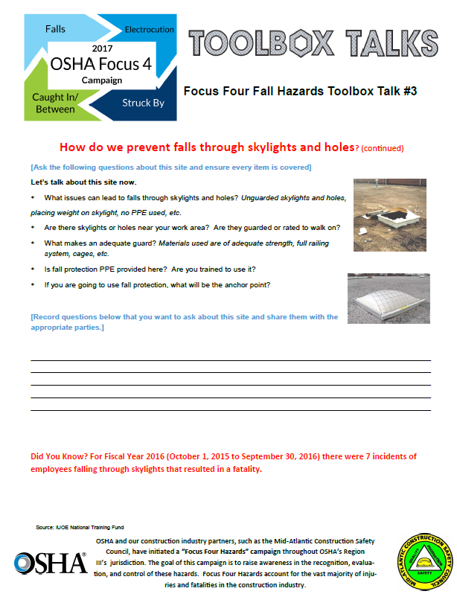
#3 – How Do We Prevent Falls through Skylights and Holes?

Slide 24
# 4 – How Do We Prevent Falls from Aerial Lifts?

Slide 25
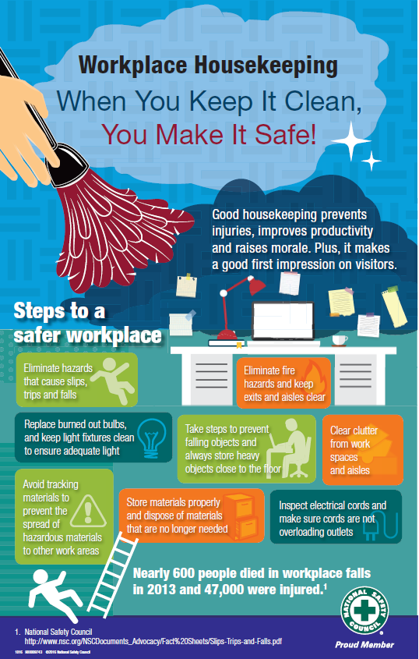
H
O
U
S
E
K
E
E
P
I
NG

Slide 26
Plan Provide Train

Slide 27
Technology to the Rescue?
Harness Hero (GC and Bridge Editions)
NIOSH Ladder App

Slide 28
Plan Provide Train

Slide 29
Resources
www.stopconstructionfalls.com
Occupational Safety and Health Administration (OSHA)
https://www.osha.gov/SLTC/etools/construction/index.html
www.osha.gov/stopfalls
National Occupational Safety and Health Institute (NIOSH)
http://www.cdc.gov/niosh/construction/
Electronic Library of Construction Occupational Safety & Health (elcosh)
http://www.elcosh.org/index.php
The Center for Construction Research and Training (CPWR)
http://www.cpwr.com

Slide 30
Resources
American National Standards Institute (ANSI) – A.10 Construction and Demolition Standards
Vendors – Grainger, Capital Safety
Suppliers – United Rentals, Sunbelt, Hertz
Manufacturers – Mine Safety Appliances (MSA), 3M, DBI Sala, Guardian
OSHA – Pennsylvania Consultation Office
Indiana University of PA
(800) 382-1241 or (724) 357-4095
Internet – Two Clicks Away for Anything
Keystone Contractors Association

Slide 32
Carl Heinlein, CSP, ARM
Senior Safety Consultant
American Contractors Insurance Group
Direct: 724-935-1650
Cell: 412-818-1161
carl.heinlein@acig.com

